Slide 1
Bandit Bash! An your adventure game
Written and created by Jacob Russell

Slide 2
Stage 1: Plotting
My Plan at the start:
Fantasy Themed
Completely different paths
Very User Friendly
A Test of my own skill in Coding and Writing

Slide 3
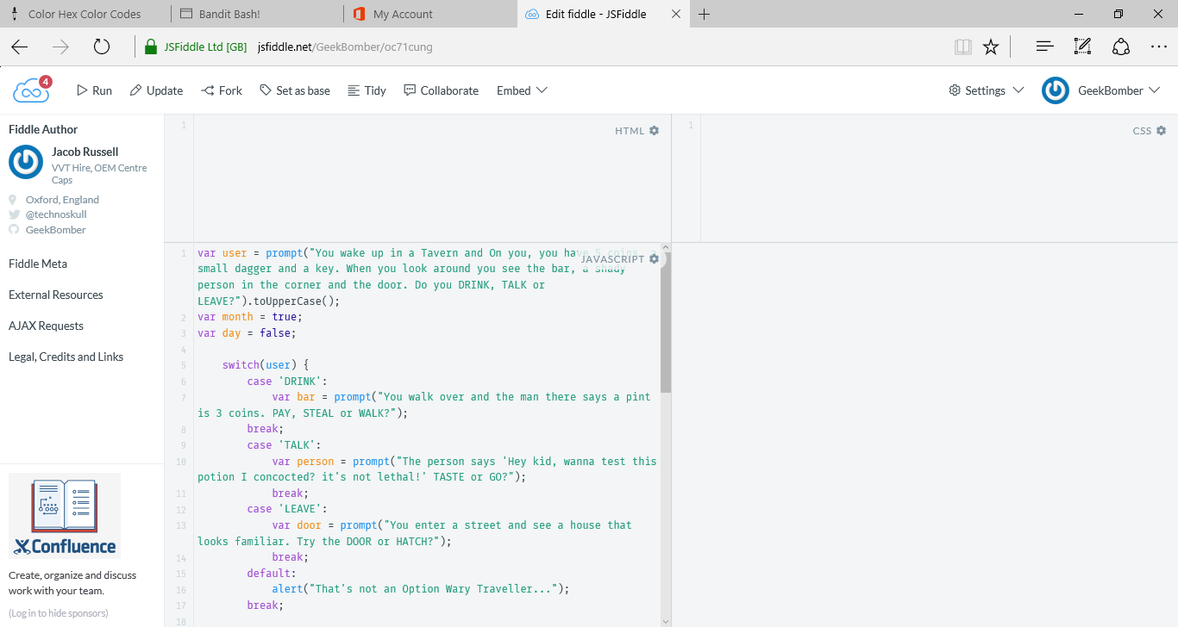
Stage 2: basic layout
I started the Game being written on jsfiddle.net, As it was easy to test without much hassle, and it worked. It was completely run through prompts (webpage questions). I had the first 2 – 3 levels down and written.

Slide 4
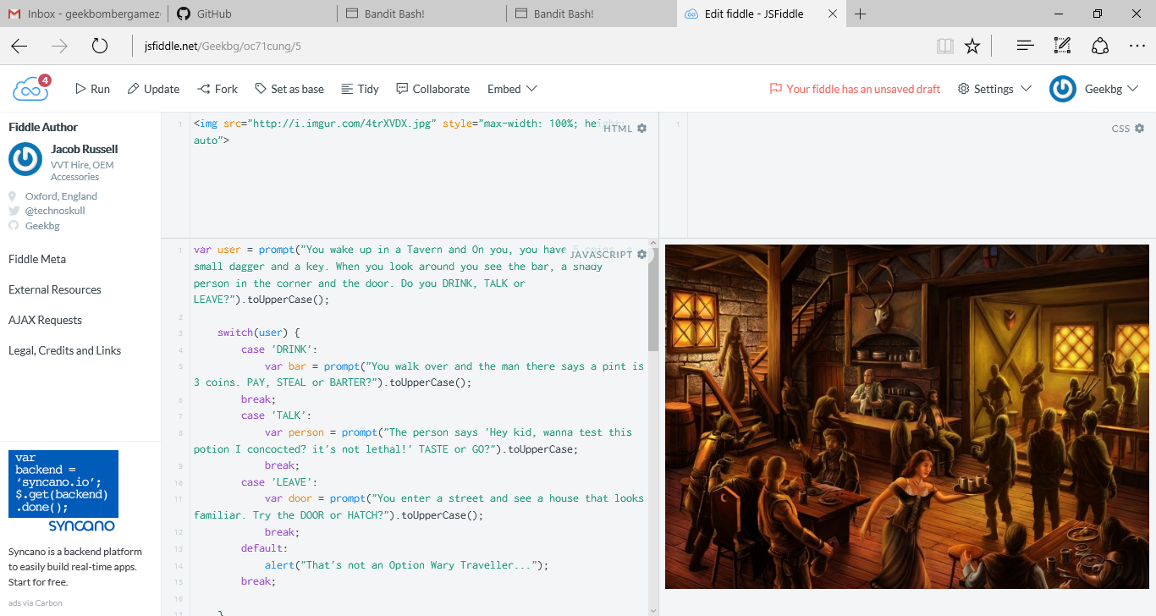
Stage 3: New Scene
After I had the simplistic questions layout, I wanted it to 1: Be more Appealing 2: Be easier to picture. I found this image of a fantasy tavern which was practically what I pictured when I first described the scene.

Slide 5
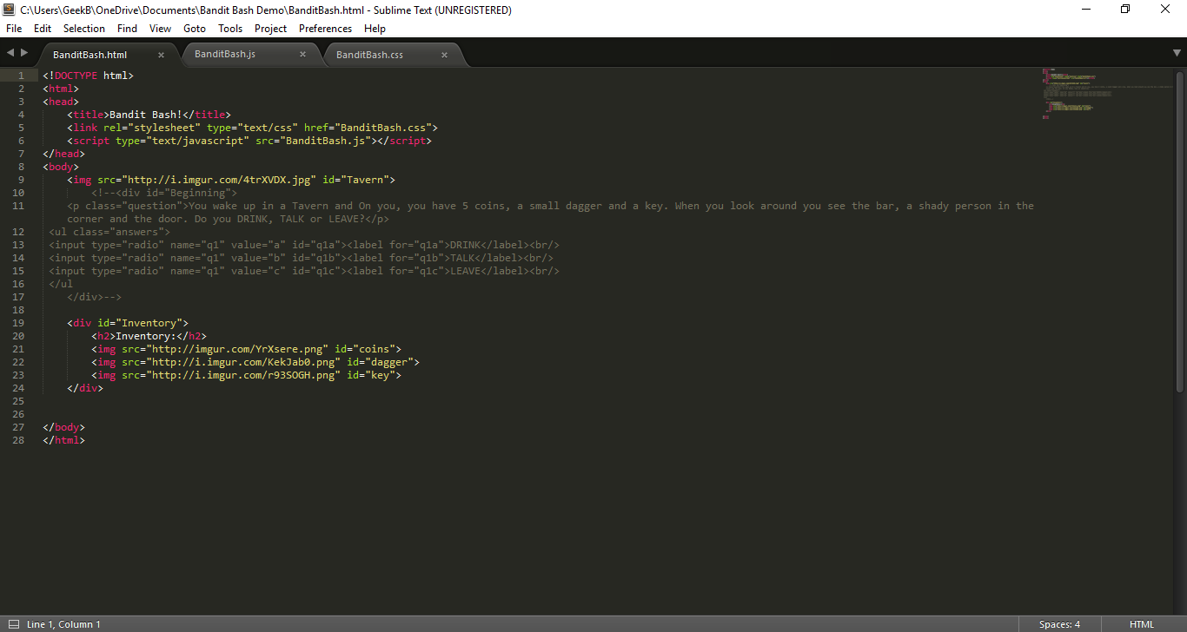
Stage 4: Getting an Upgrade!
Once I got the Starting layout, I grew bored of the white screen in JSfiddle and upgraded to Sublime Text 3. It was so much easier to work on and I could collaborate with my Uncle

Slide 6
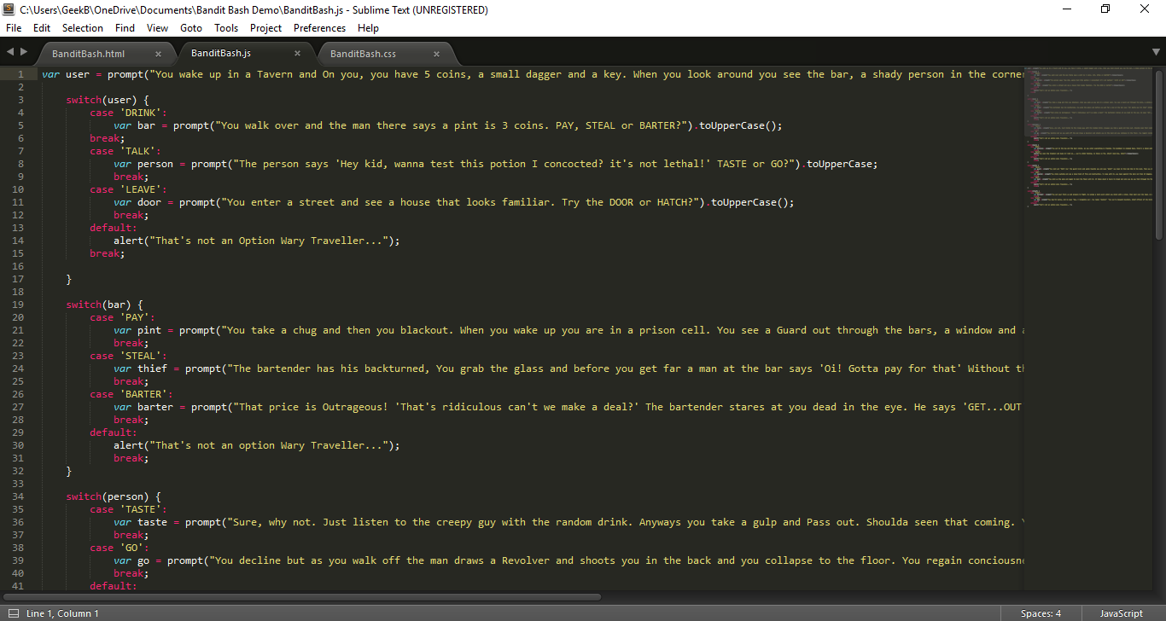
Stage 5: Fresh System
I had gotten to about 15 – 20 questions and the prompts got out of hand, and couldn’t keep up. I had to change to something new. My solution (at the time) was…
SWITCHES!

Slide 7
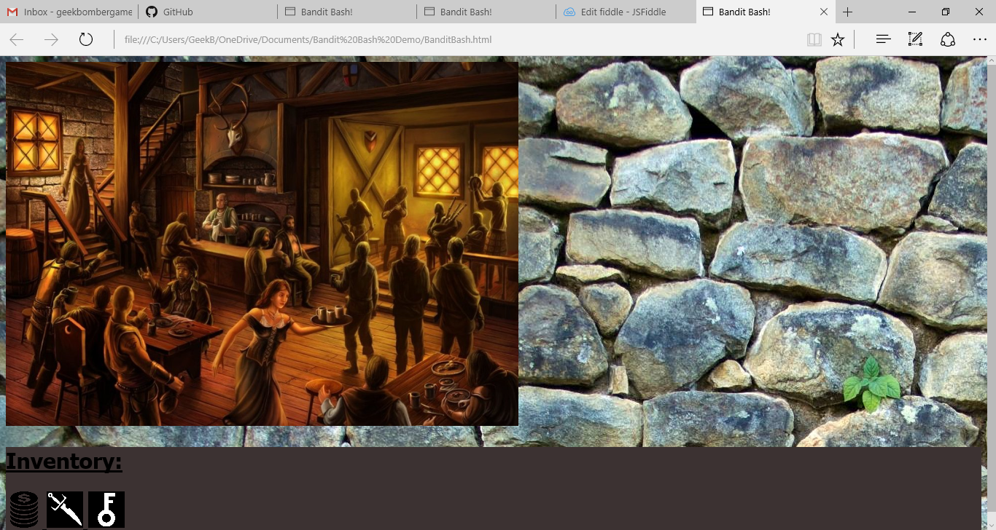
Stage 6: UI (User Interface)
I already had the Tavern Image, but it didn’t feel like a game, It was too bland. My solution? Inventory. It was supposed to look like a Dungeon Crawler mixed with and RPG.

Slide 8
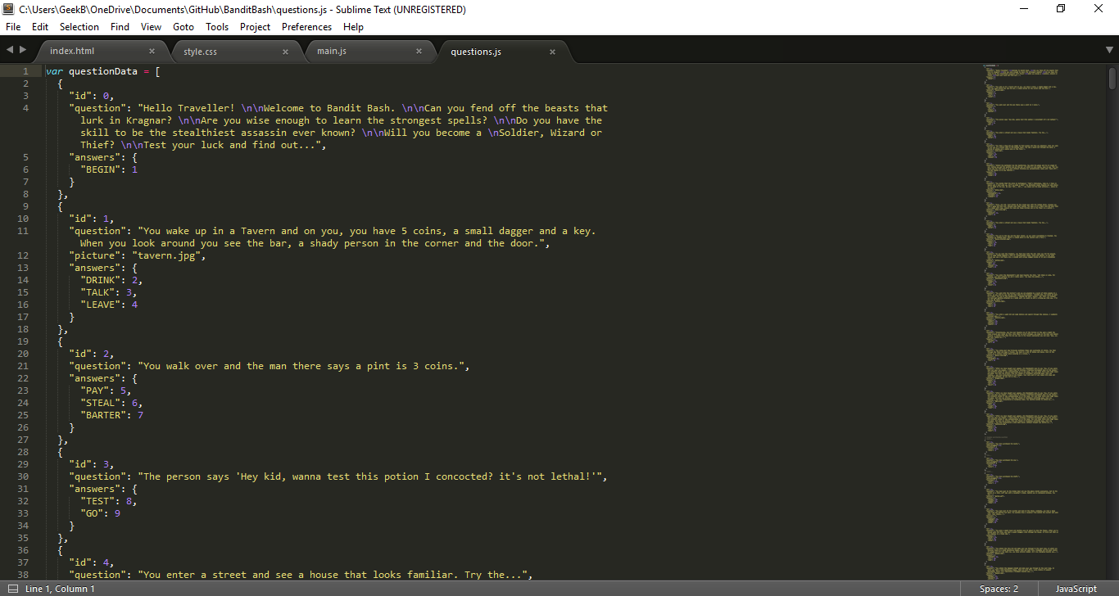
Stage 7: BUTTONS!
After I had made the UI, I realised that you couldn’t play and see the UI at the same time, so (Credit to my Awesome Uncle) the switches was replaced with objects and buttons, which was incredibly easier to manage and organise.

Slide 9
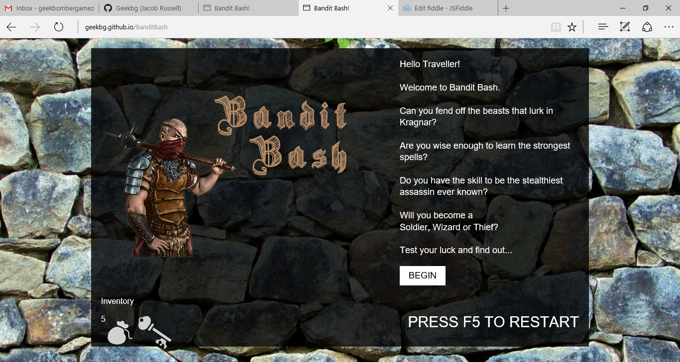
Stage 8: Updated UI
When the buttons were introduced, we needed somewhere to put them. But instead of adding it in, we just completely changed it. It looks better this way anyways.

Slide 10
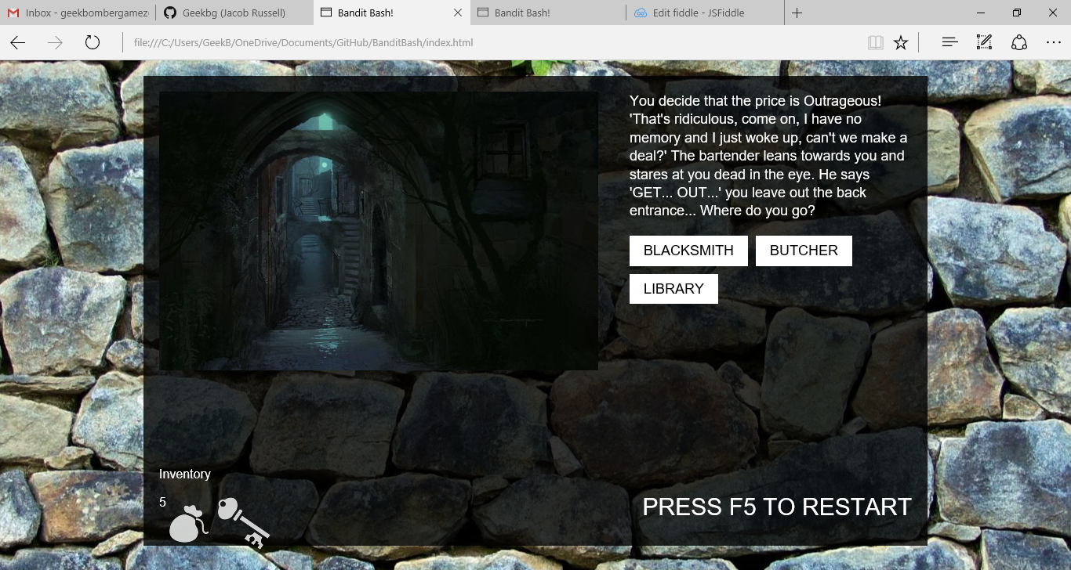
Stage 9: Linked Images
When I say Linked Images, I don’t mean it leads anywhere but that it is connected with the questions. For example, when your character gets kicked into the alley way, The image changes to the provided Alley way image.

Slide 11
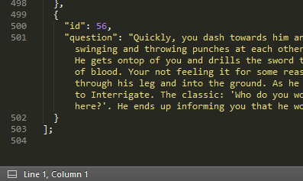
Stage 10: Filler
From there on it was just adding more and some debugging here and there. Overall, I believe that It came out as I wanted it to. It’s not Triple A, 10/10, award-winning experience but that’s not what I was expecting.

Slide 12
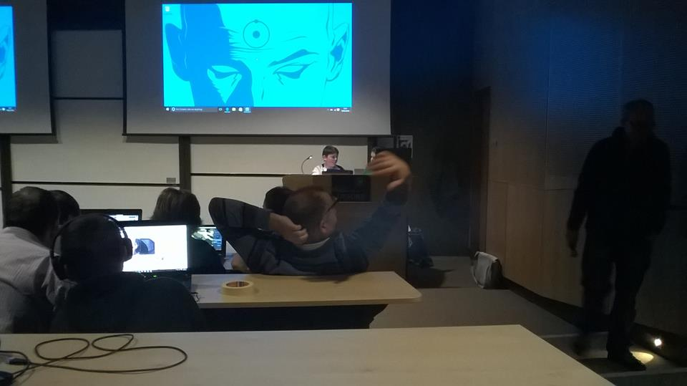
Final Stage: Now!
I finished the game and I remembered that this event was coming up soon so I decided to make this PowerPoint and prepare to present it to all of you here today.

Slide 13
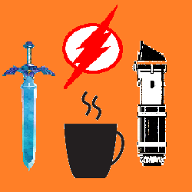


How to Find me
Twitter: GeekBomber (@technoskull)
GitHub: Geekbg
Email: GeekBomberGamez@gmail.com
The Game: http://geekbg.github.io/BanditBash

